Slide 1
Chongqing University of Technology
ATAI
Advanced Technique of Artificial Intelligence
Chongqing Unive
Deep Attention Diffusion Graph Neural Networks
for Text Classification
Reported by Jia Wang
（EMNLP-2021)
Notes:
基于深度注意扩散图神经网络的文本分类

Slide 2
Chongqing University of Technology
ATAI
Advanced Technique of Artificial Intelligence
Chongqing University of Technology
1. Introduction
2. Approach
3. Experiments

Slide 3
Introduction
Despite the success of the mentioned models, several serious limitations of prevalent GNNs hinder their performance,which is mainly attributed to the following factors:
• Restricted Receptive Fields :
Most previous approaches allow a word in the graph to access direct neighborhoods. Moreover, the sliding window used to build word-word edges is typically not large.
• Shallow Layers :
A common challenge faced by most GNNs is that performance degrades severely when stacking multiple layers to exploit larger receptive fields.
• Non-Precision Document-Level Representations :
This weakens the effect of some key nodes and significantly reduces the expressiveness of the model since different words play distinct roles in the text.
• Low-Pass Filters :
It has been confirmed that the low-pass filter in GNNs mainly preserves the commonality of node features, ignoring the difference among them.
Notes:
文本分类是自然语言处理中的一项基础性工作，有着广泛的应用。近年来，图神经网络因其强大的表示能力而受到广泛关注。然而，现有的基于GNN的文本分类方法大多只考虑了单跳邻域和文本中的低频信息，不能充分利用文档丰富的上下文信息:此外，用于构建单词-单词边缘的滑动窗口通常并不大。这使得远程文字互动成为不可能。文本分类的性能在很大程度上依赖于模型从原始文本中提取文本特征的能力

Slide 4
Introduction
Our work’s key contributions are as follows:
• We introduce a novel model, namely, DADGNN, based on the attention diffusion and
decoupling technique, which has excellent expressive power in modeling documents and overcomes some limitations of conventional graph-based models.
• We theoretically prove that the attention diffusion operation is equivalent to a polynomial graph filter that can utilize both high- and low-frequency graph signals.
• We conduct extensive experiments on a series of benchmark datasets, and the state-of-the-art performance of DADGNN illustrates its superiority compared to other competitive baseline models.
Notes:
文本分类是自然语言处理中的一项基础性工作，有着广泛的应用。近年来，图神经网络因其强大的表示能力而受到广泛关注。然而，现有的基于GNN的文本分类方法大多只考虑了单跳邻域和文本中的低频信息，不能充分利用文档丰富的上下文信息:此外，用于构建单词-单词边缘的滑动窗口通常并不大。这使得远程文字互动成为不可能。

Slide 5
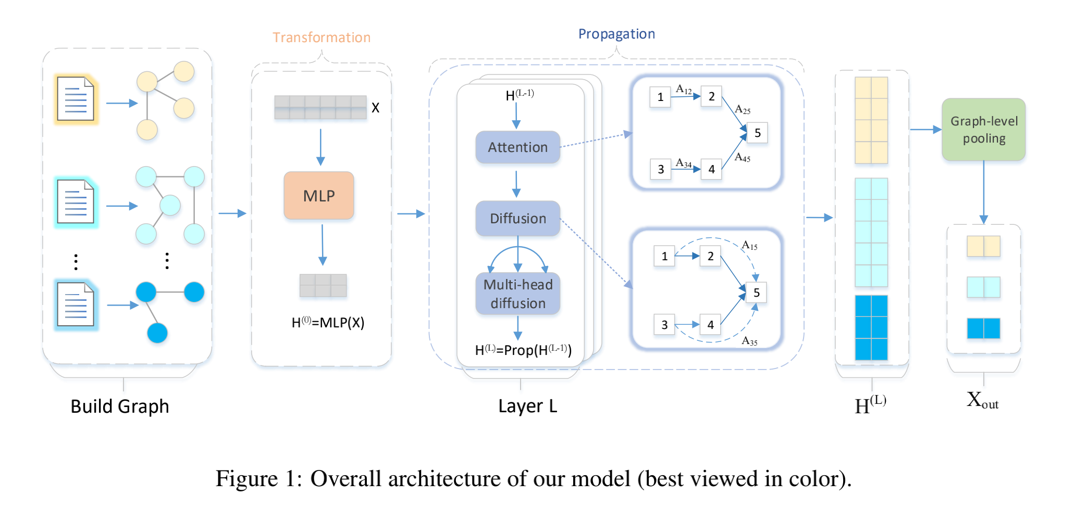
Approach

Slide 6
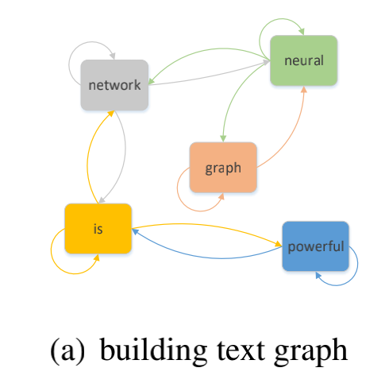
Approach
Text Graph Construction

Slide 7
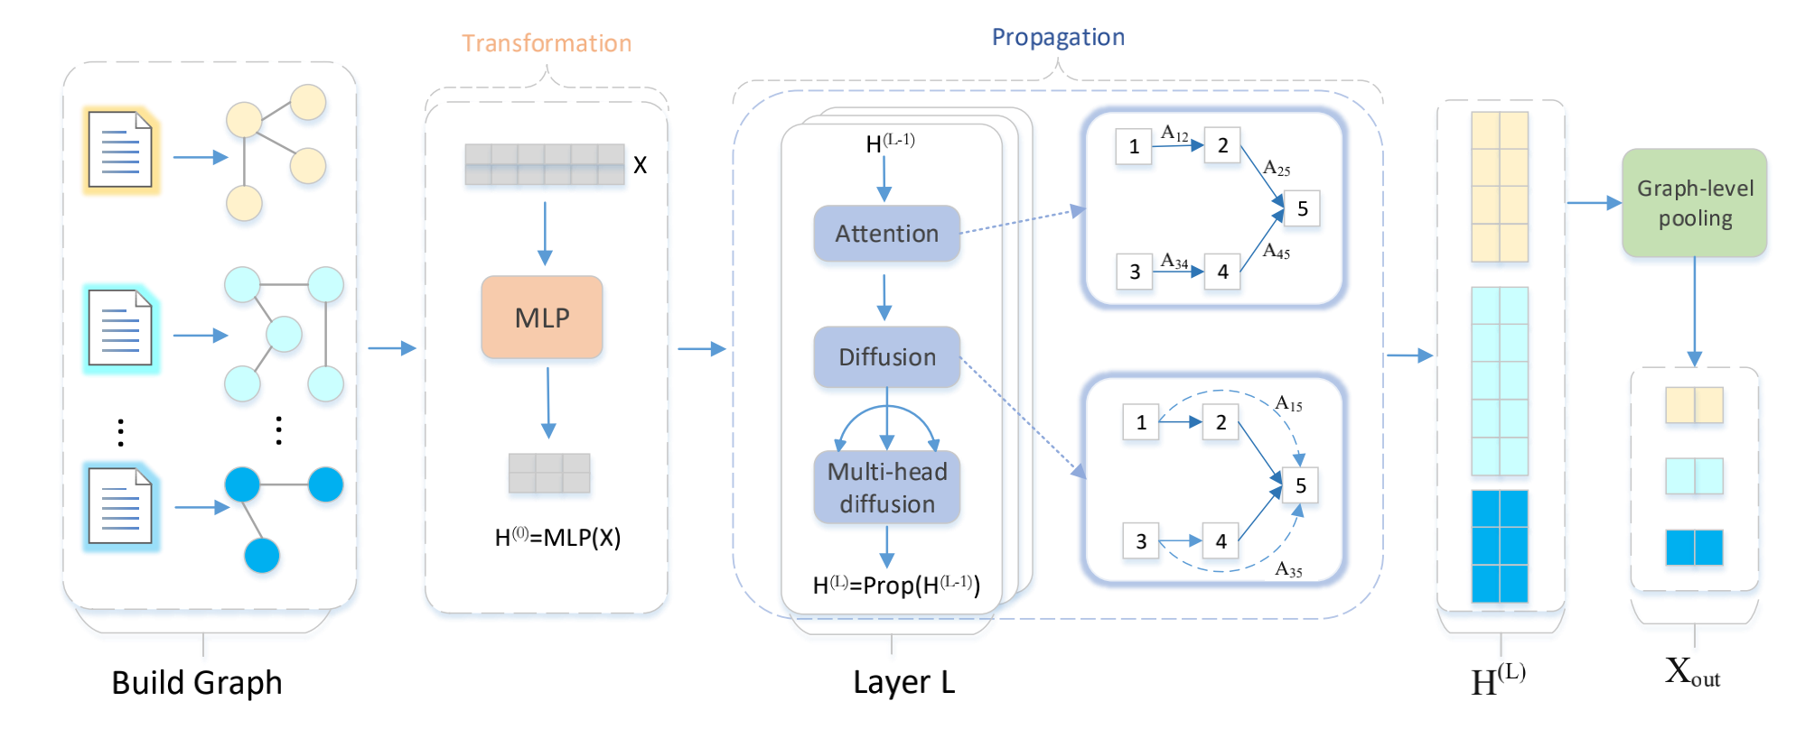
Approach
Key Components

Slide 8
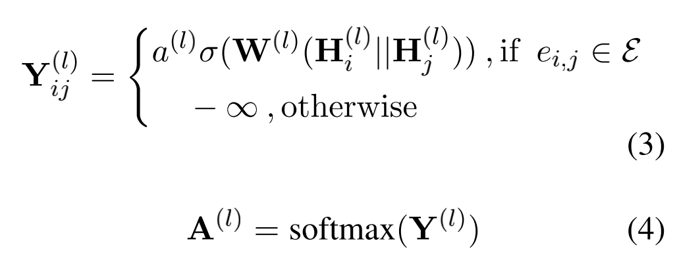
Approach
Key Components
Notes:
然后，计算直连节点间的归一化注意力权重

Slide 9
Approach
Key Components
Notes:
我们通过扩散机制计算复杂网络中不直接连接的节点之间的注意力
Γ(图的注意扩散矩阵)
为了进一步提高注意-注意扩散层的表达能力，我们提出了一种多头注意-注意扩散机制。具体来说，我们首先计算每个头部依赖的注意扩散，然后对它们进行聚合。输出特征表示如下

Slide 10
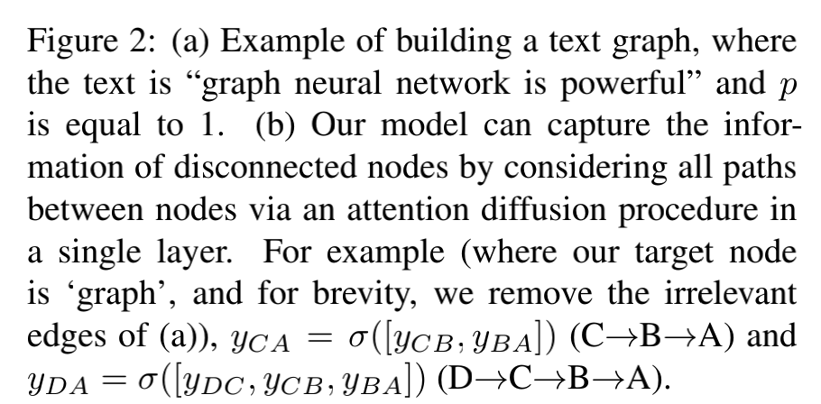
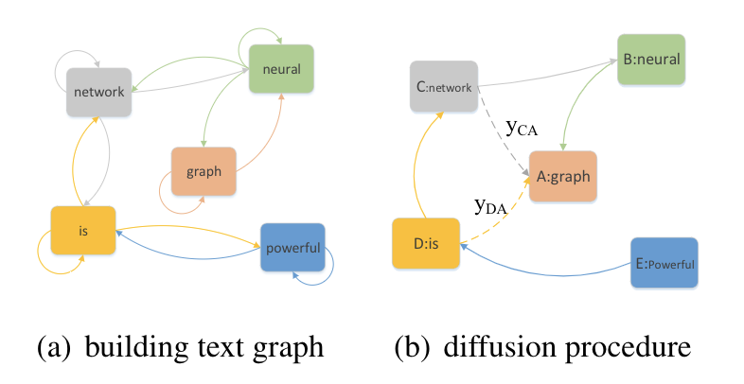
Approach
Key Components
Notes:
我们通过扩散机制计算复杂网络中不直接连接的节点之间的注意力
Γ(图的注意扩散矩阵)
为了进一步提高注意-注意扩散层的表达能力，我们提出了一种多头注意-注意扩散机制。具体来说，我们首先计算每个头部依赖的注意扩散，然后对它们进行聚合。输出特征表示如下

Slide 11
Approach
Graph-Level Representation

Slide 12
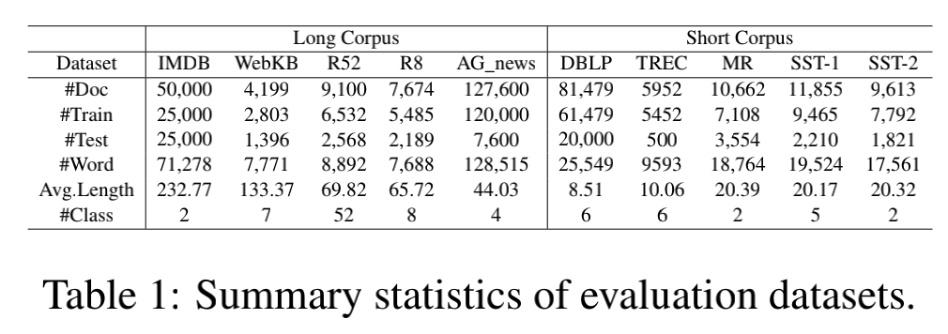
Experiments
Notes:
Multi-task learning methods（MTL）

Slide 13
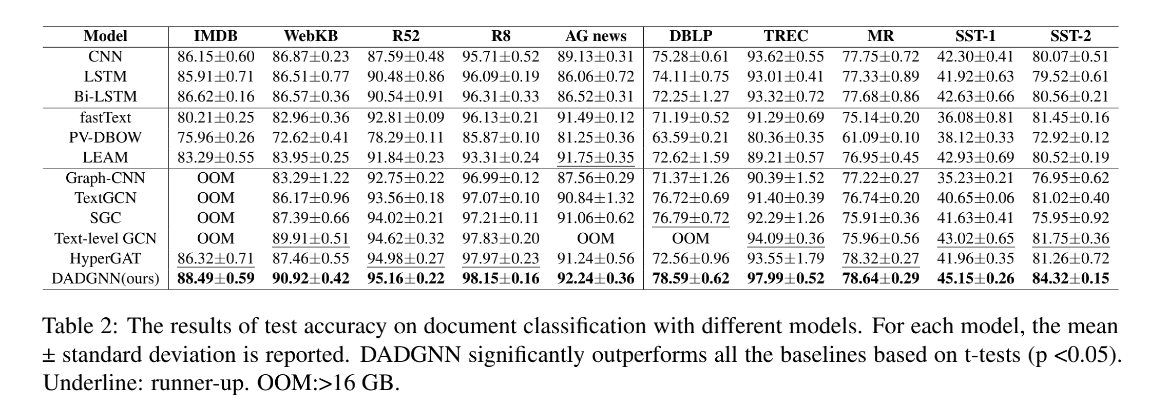
Experiments
Notes:
不同输入类型的司法事实的结果比较
夫妻债务 利益纠纷

Slide 14
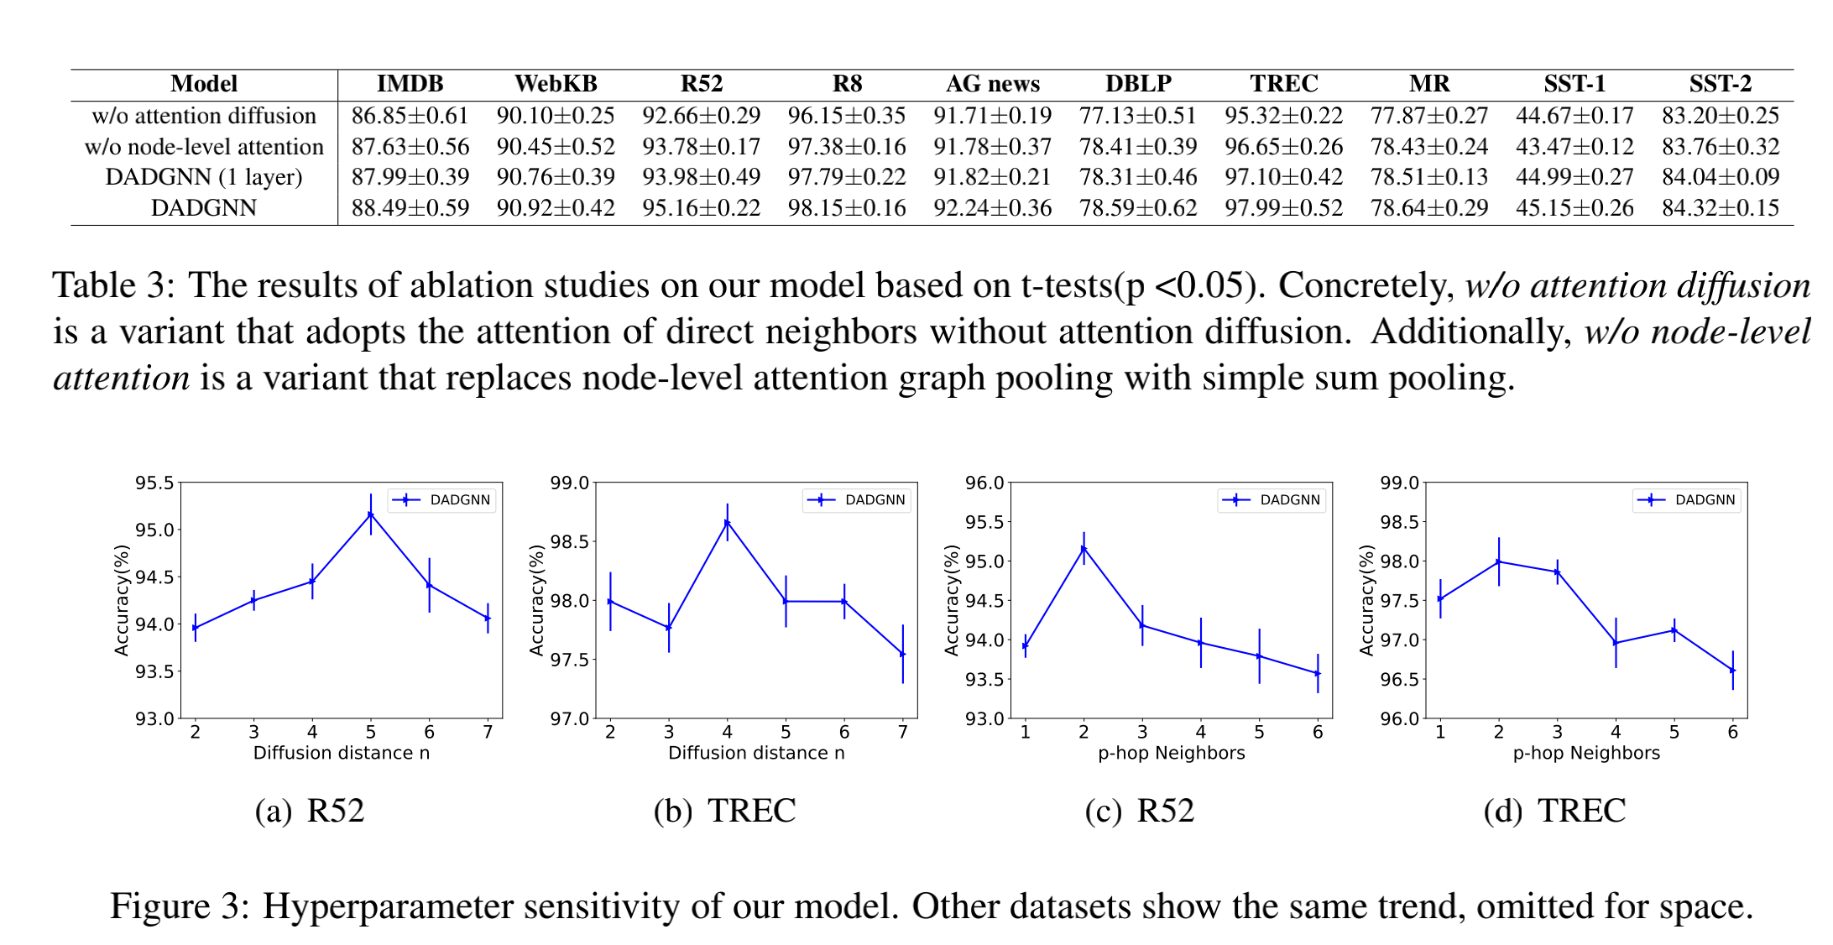
Experiments

Slide 15
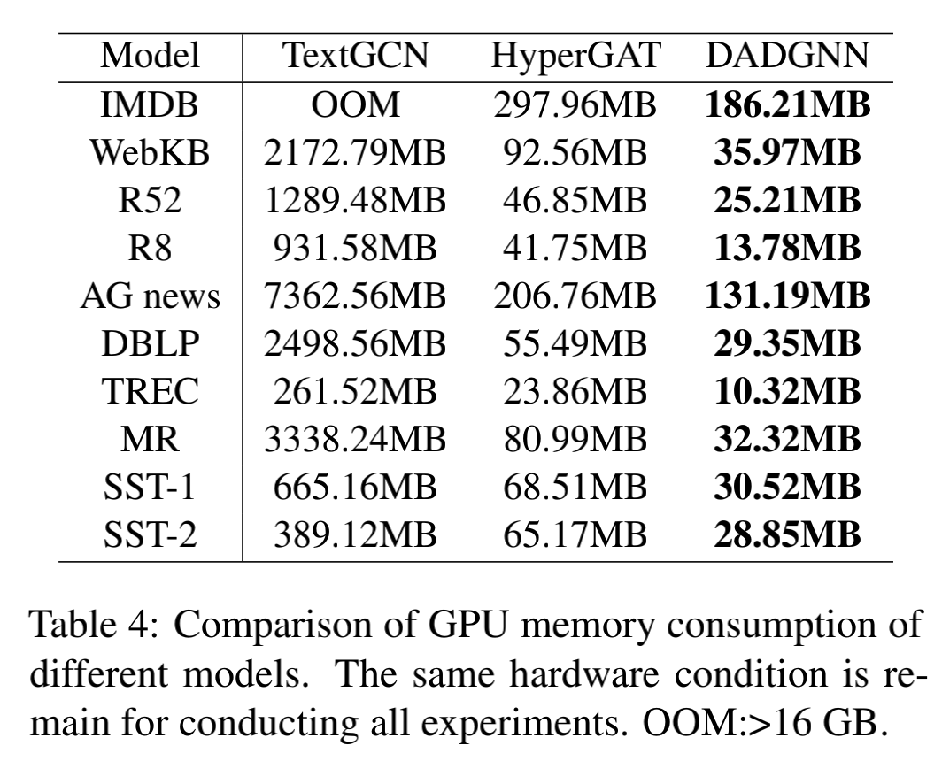
Experiments

Slide 16
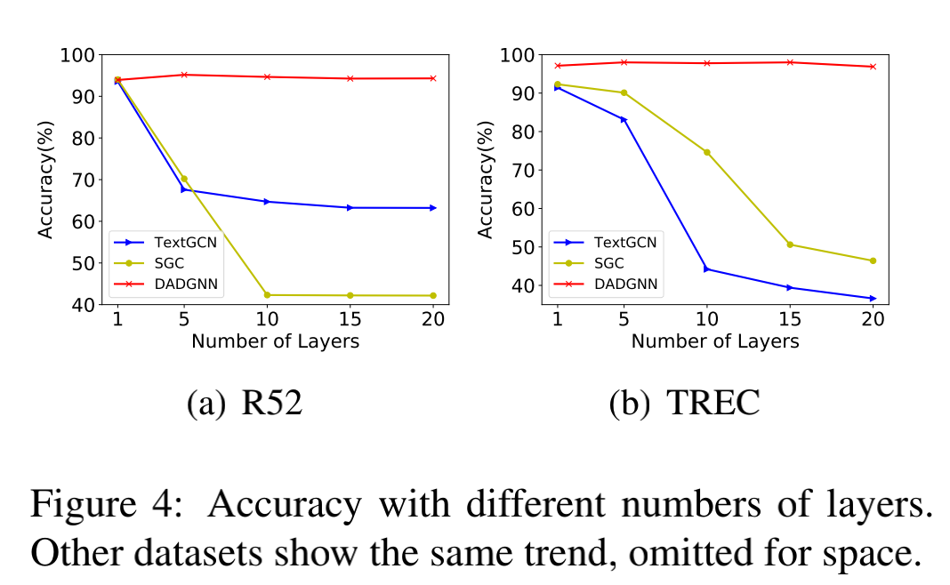
Experiments

Slide 17
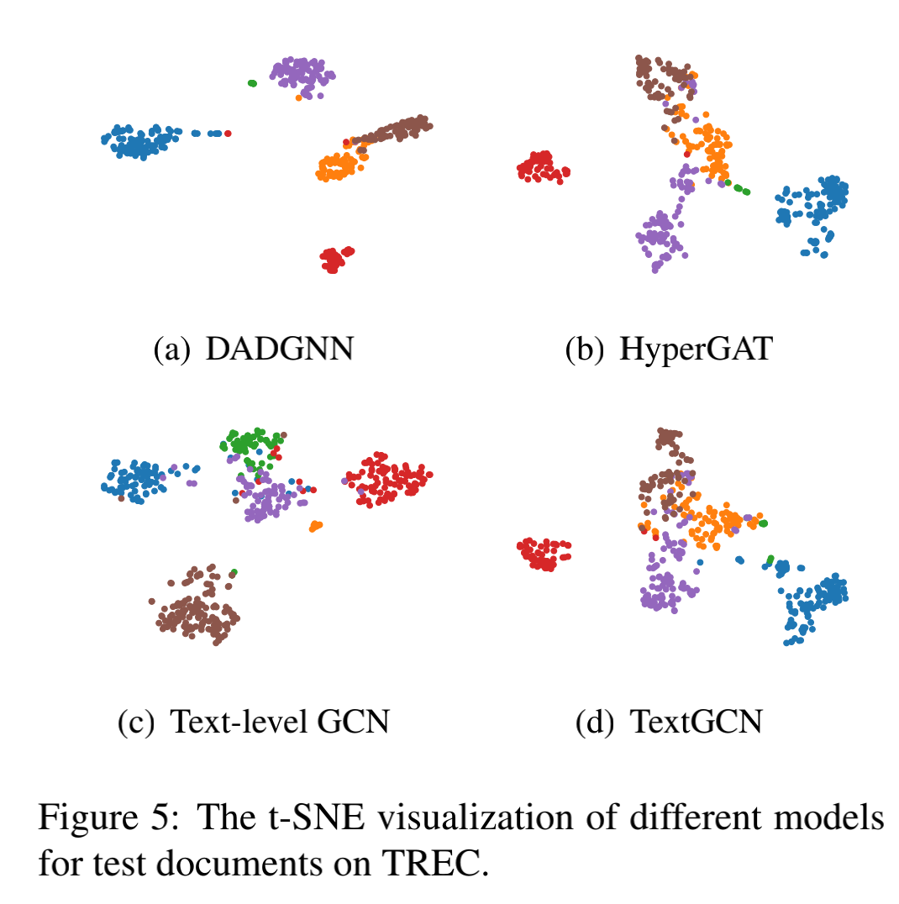
Experiments

Slide 18
Thanks！

